Slide 1
2024 Hays CISD Finance Training & Updates
Budget

Slide 2
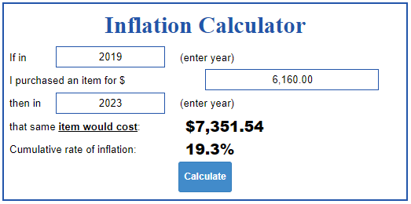
State of the Budget
Campuses reduction to Print Shop budgets ONLY.
Department reductions/ IMTA, E-Rate, and Bond Interest.
Factors
Legislative year- funding
(Special Session in October)
Attendance
Payroll costs
Inflation

Slide 3
Object | Object Description | 2024 Budget | %
6100 | Payroll Costs | $ 207,461,179.00 | 87.8%
6200 | Professional & Contract Services | $ 13,868,313.00 | 5.9%
6300 | Supplies & Materials | $ 10,092,958.00 | 4.3%
6400 | Other Operating Expenses | $ 4,141,118.00 | 1.8%
6600 | Capital Outlay | $ 715,051.00 | 0.3%
 |  | $ 236,278,619.00

Slide 4
Hays CISD Departments
Athletics | Legal Services
Audit Services | Library
Campuses | Maintenance & Operations
Career & Tech | PEP Program
Communication | Performing Arts Center
Construction | School Board
Copiers | Security
County Appraisal Districts | Special Education
Curriculum & Instruction | SRO's
Custodial Services | Summer School
Financial Services | Superintendent
Fine Arts | Technology
Health Services | Transportation
Human Resources | Utilities

Slide 5
Account Structure- Examples
 | Fund | Function | Object | Sub-Object | Hays Org | Program | Responsibility | Assignment
General Fund Account | 199 | 11 | 6399 | 00 | 119 | 11 | 1 | 0
Federal Grant Account | 2112 | 11 | 6399 | TE | 046 | 30 | 1 | 0
Activity Fund Account | 877 | 36 | 6412 | 00 | 006 | 99 | 1 | AF127

Slide 6
TEA Resource Guide
TEA- Texas Education Agency
Financial Accountability System Resource Guide (FASRG)
https://tea.texas.gov/sites/default/files/fasrg17-module1-farappendices-final-accessible.pdf

Slide 7
TEA Resource Guide

Slide 8
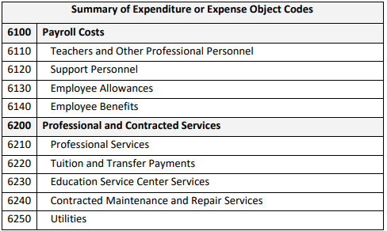
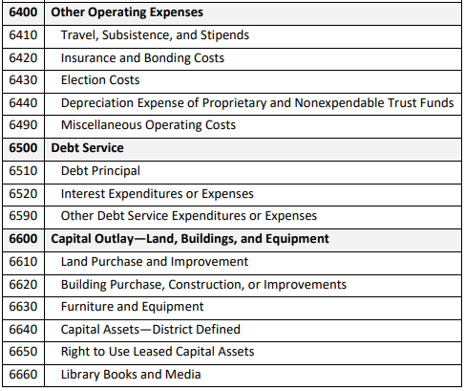
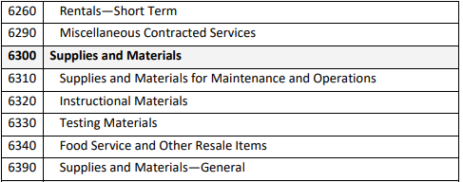

Slide 9
MUNIS- Account Inquiry
NOTE: Click “Search” > the “Search” button becomes the “Accept” button > Click “Accept” for open ended search.
*Current Fiscal Year
is 2024

Slide 10
Account Inquiry- Segment Find
First click on “Segment Find” brings up this menu.
NOTE: Use “Segment Find” to look at a specific group of accounts.
Example: Comp Ed Accounts

Slide 11
Account Inquiry- Segment Find
NOTE: By clicking on the three dots next to “Function”, a menu of all available functions will pop up. You can do this for each segment.
NOTE: You can export these lists to EXCEL by clicking on the EXCEL button (CIRCLED ABOVE).
First click on “Segment Find” brings up this menu.
NOTE: Use “Segment Find” to look at a specific group of accounts.
Example: Comp Ed Accounts

Slide 12
Account Inquiry- Segment Find
NOTE: You can export these lists to EXCEL by clicking on the EXCEL button (CIRCLED ABOVE).
NOTE: By using the vertical bars between your selections, you’re able to grab specific account segments and only those segments.
NOTE: By using the colon or asterisk, you can grab a range of account segments.
First click on “Segment Find” brings up this menu.
NOTE: Use “Segment Find” to look at a specific group of accounts.
Example: Comp Ed Accounts

Slide 13
Account Inquiry- Account Detail
“What’s the difference between Original and Revised Budget?”
“What is my true available balance?”
“How do I see the details of my expenses?”
“What is ACTUAL?”

Slide 14
Account Inquiry- Account Detail
NOTE: Each yellow folder has the detail of the amount.
**This is a magnified view of your ribbon (below)

Slide 15
Budget Transfers- Reminders
WHOLE dollars only in your transfer amounts (no pennies or change).
One and only exception is SAF (Student Activity Funds).
Transfers with pennies will be rejected.
Cross function transfers require Board approval.
Generally, approval happens once a month.
After Board approval, the transfers will be posted.
Absolutely no cross fund transfers allowed.

Slide 16
MUNIS- Budget Transfers
Step One: Click “Add”

Slide 17
MUNIS- Budget Transfers
Step Three: Click “Accept”.
Step Two: Most fields will default. Ensure fields are correct. Enter “short description”. All fields with a red star (*) must be populated.
Step Four: Enter “Account Number”> Enter I/D or Increase/Decrease> Enter Amount.
NOTE: These amounts should match.

Slide 18
MUNIS- Budget Transfers
**Ignore “Project String”
NOTE: Use the “three dots” (circled red above) on account number if you’re unsure of account or how to enter between the dashes.
NOTE: Warnings will appear if you are transferring more than the account balance.

Slide 19
MUNIS- Budget Transfers
Step Six: Click the “Release” button.
NOTE: Journal Number for reference.
Step Five: Double check amounts are correct and matching. Double check proper accounts are reflected. > Click “Back” button.
NOTE: “Amendment Status” will change to “Pending Approval” after clicking “Release”.

Slide 20
THANK YOU!

